Slide 1
DSA LAB PROJECT
TICKET SYSTEM
Dynamic Ticket Reservation and Cancellation System

Slide 2
01
02
03
IRTAZA
AWAIS
HARIS
GROUP MEMBERS
04
MAHIR

Slide 3
PROJECT FUNCTIONS
The Ticket Reservation System is a Java-based application designed to manage seat bookings, cancellations, and reservations for events, theaters, or transportation services (like flights or trains). It provides a structured way to:
1-Book seats (Economy, Premium, VIP)
2-Cancel reservations
3-Undo bookings/cancellations (using Stack-based history)
4-Check seat availability
5-Generate reports (bookings, revenue, popular seats)

Slide 4
PROJECT DETAIL
STATEMENT
VISION
The Ticket Reservation System is designed to provide a reliable, efficient, and user-friendly platform for managing seat bookings across various venues (theaters, cinemas, flights, trains, or stadiums). It ensures: ✔ Real-time seat availability tracking ✔ Secure booking & cancellation management ✔ Undo/Redo functionality for error recovery ✔ Automated reporting for business insights
This system eliminates manual errors, optimizes seat allocation, and enhances customer experience by maintaining a structured reservation process.
Our vision is to develop the most intuitive and scalable reservation system that can be adapted for: 🎭 Entertainment (Cinemas, Theaters, Concerts) ✈ Transportation (Airlines, Trains, Buses) 🏟 Events (Stadiums, Conferences)
Future Goals:
🚀 AI-based seat recommendations (optimizing occupancy & revenue) 📱 Mobile/Web integration for remote bookings 💳 Secure online payment gateway support 🌍 Multi-language & multi-currency support for global use

Slide 5
CLASS
DIAGRAM

Slide 6
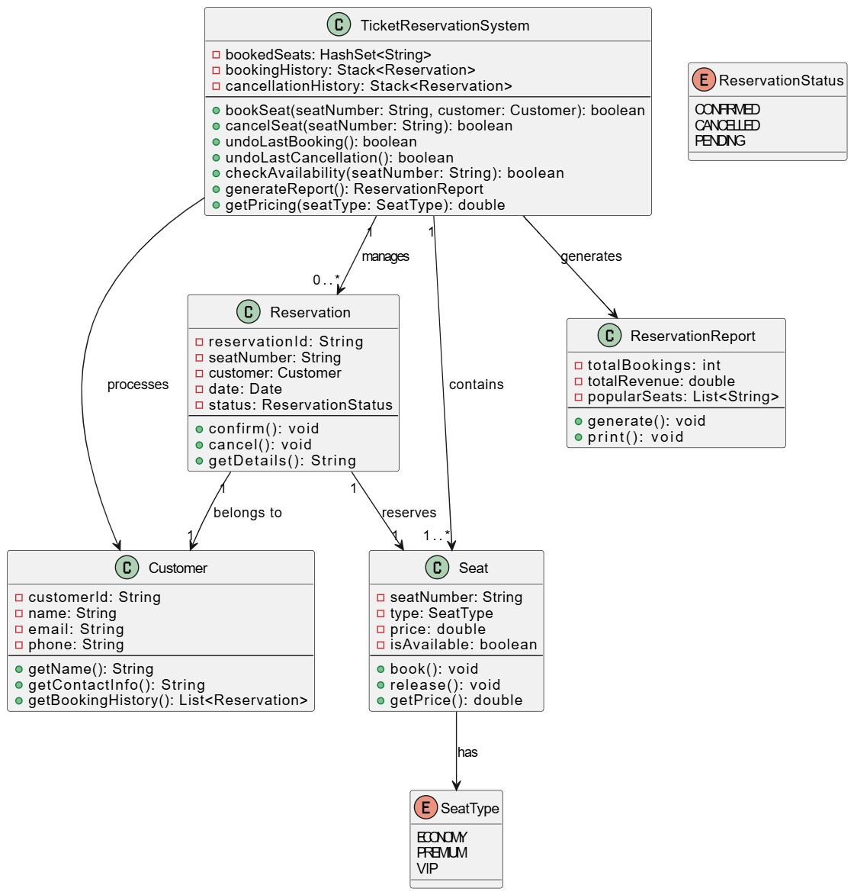
—CLASS DIAGRAM

Slide 7
CODE OUTPUT
PICTURES OF CODE WITHOUT OUTPUT

Slide 8
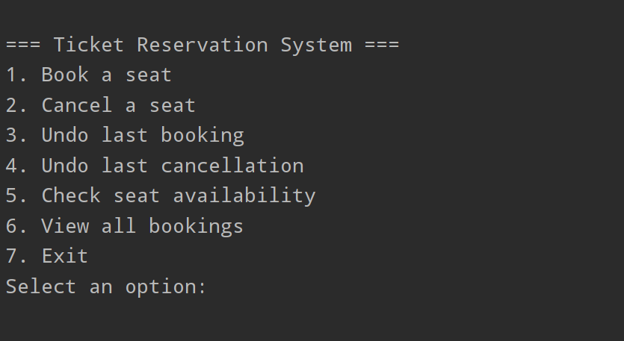
CODE OUTPUT

Slide 9




PROJECT GUI(GRAPHICAL USER INTERFACE)
GUI OUTPUT CODE PICTURES

Slide 10
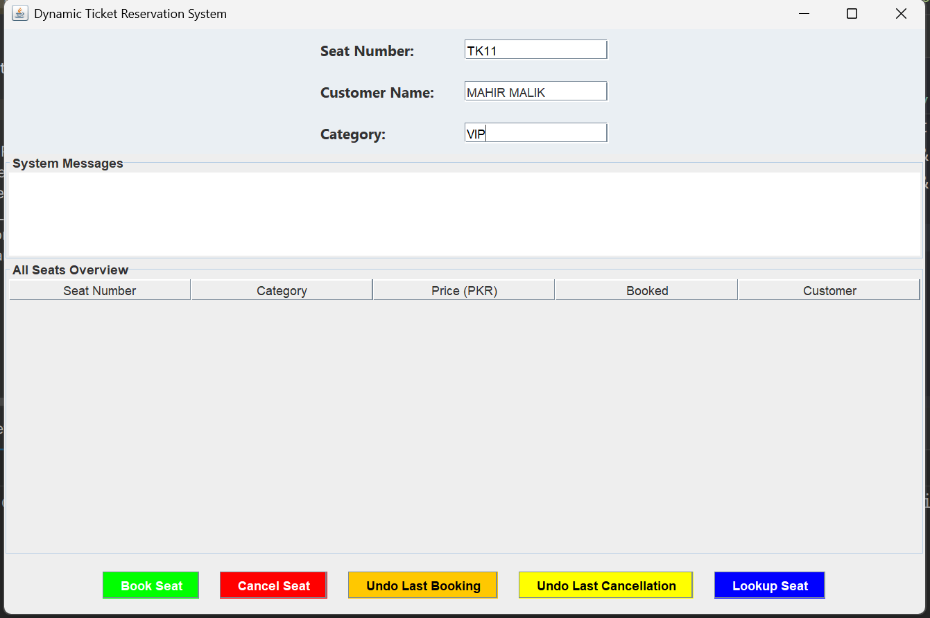
OUTUT GUI:

Slide 11
THANKS
ANY QUESTION ?

